Slide 1
Generating noisy speech data from clean data in the frequency domain using Deep Learning Methods
Week – 12
Name: Shashank Shirol
University: Manipal Institute of Technology
Duration of the presentation: ~10 mins.

Slide 2
Tasks to be completed:
To modify code to apply a ffmpeg codec to audio files followed by training using CutGAN.
To debug the code and document the results of using cross-sections to train SinGAN.
To try out different experimentational setups with CutGAN:
Training with clean domain A and codec passed domain B to determine if CutGAN catches that.
Adding a parameter that raises the spectrograms of input training files by a certain power.
Using SinGAN and CutGAN in tandem:
Train SinGAN with a noisy sample, use the model to generate audio files for domain A of CutGAN.
Use the generated files to train CutGAN and generate outputs.

Slide 3
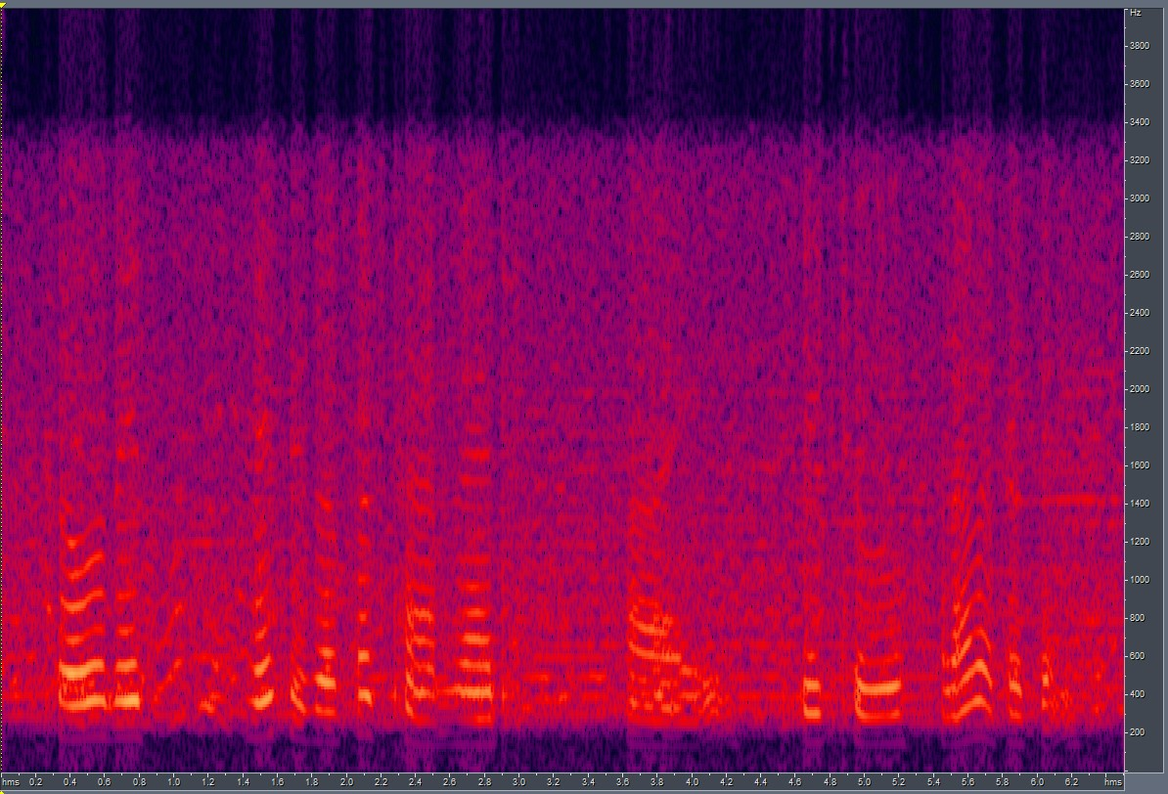
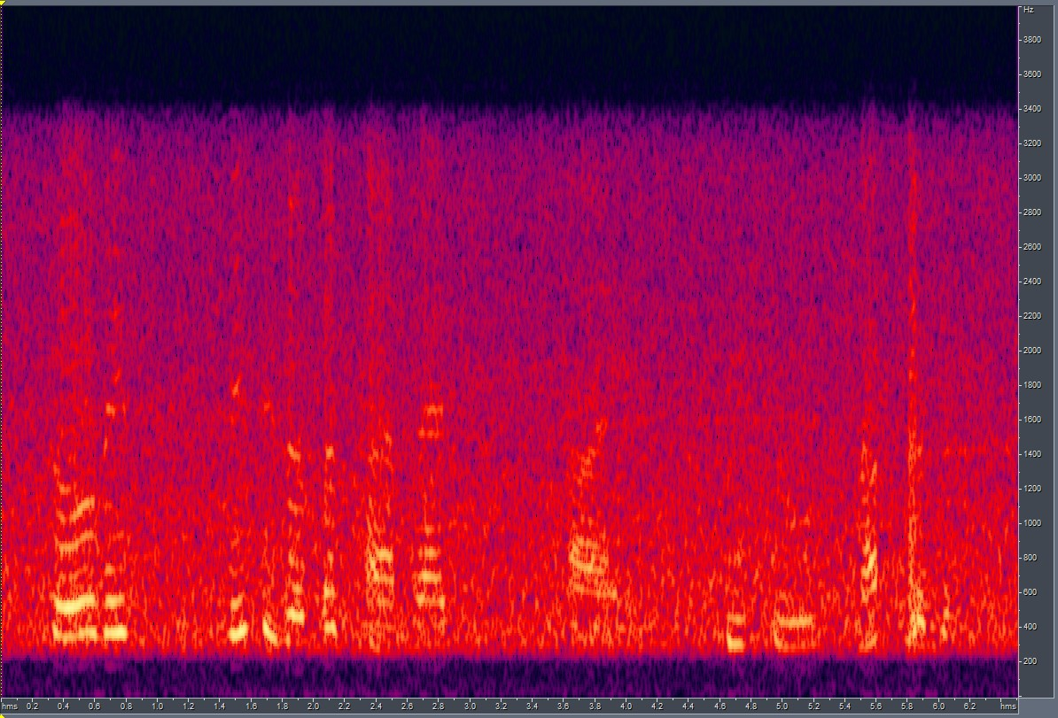
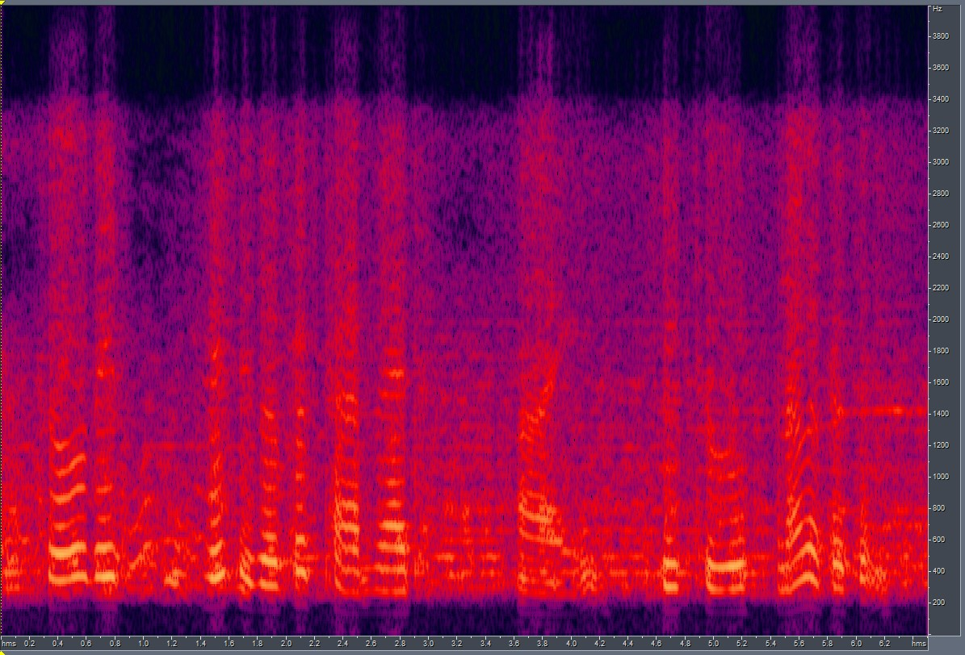

Modify code to apply a codec to audio files before training.
G726 codec passed domain A + RATs Noisy domain B.
The results were better than when we did not use a codec.
LSD scores of both setups:
When trained w codec: 6.14
When trained w/o codec: 6.815
w codec
GT
w/o codec

Slide 4
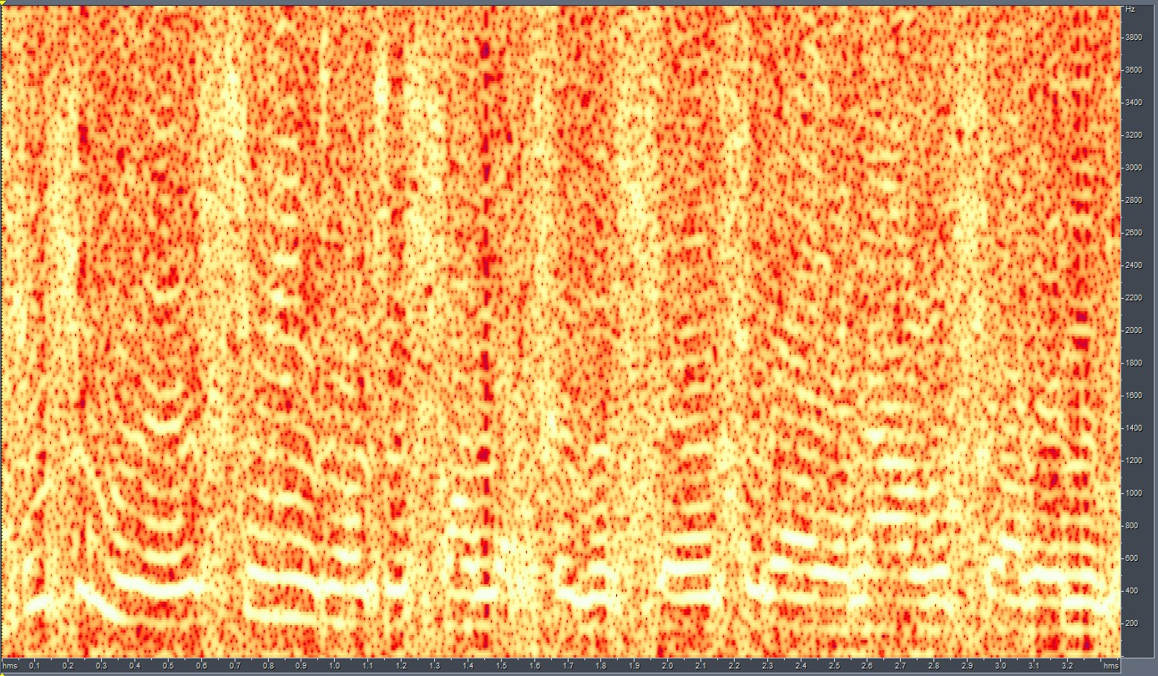
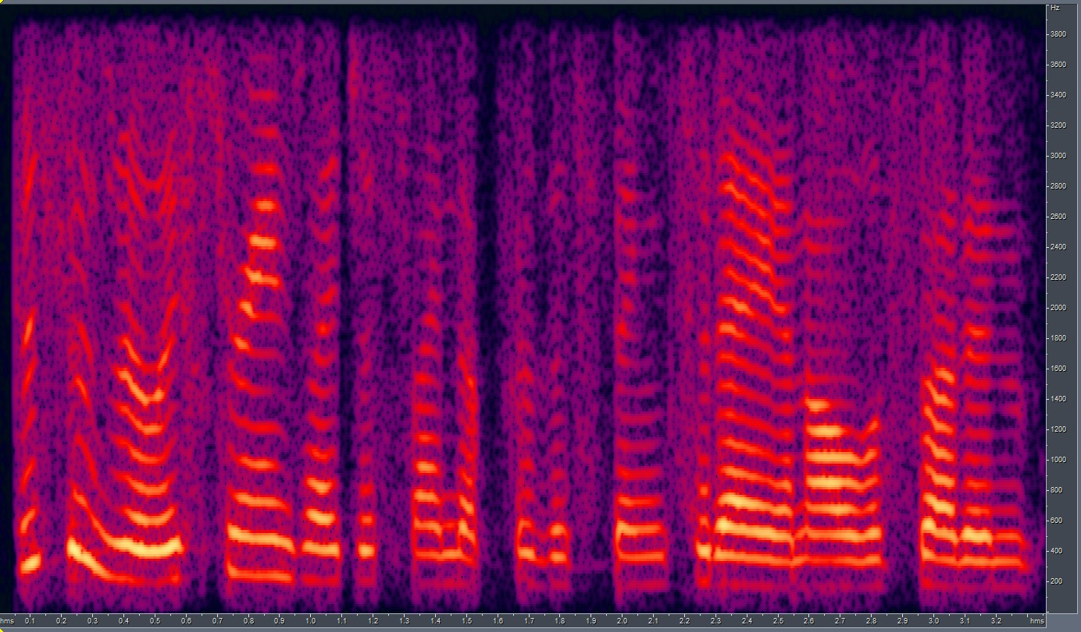
Using Vertical Cross-sections as receptive fields:
Debugged the code that makes use of vertical cross-sections as receptive field.
The output generated by training such a model is extremely noisy.
The model fails to converge, spectrogram and output generated are as follows:
Generated using final scale = 7.
Paint spec used to generate

Slide 5
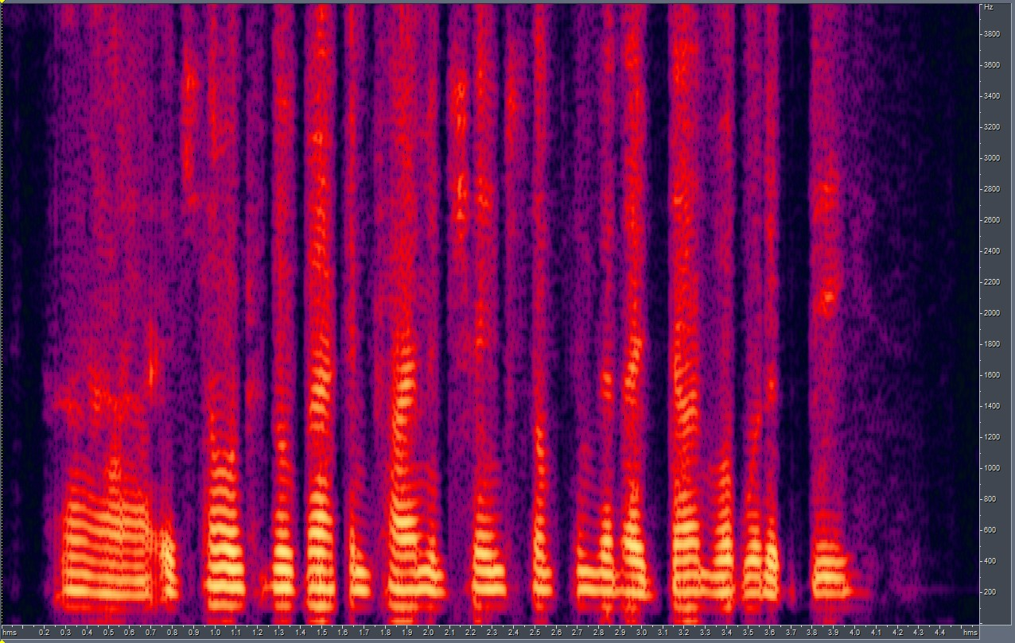
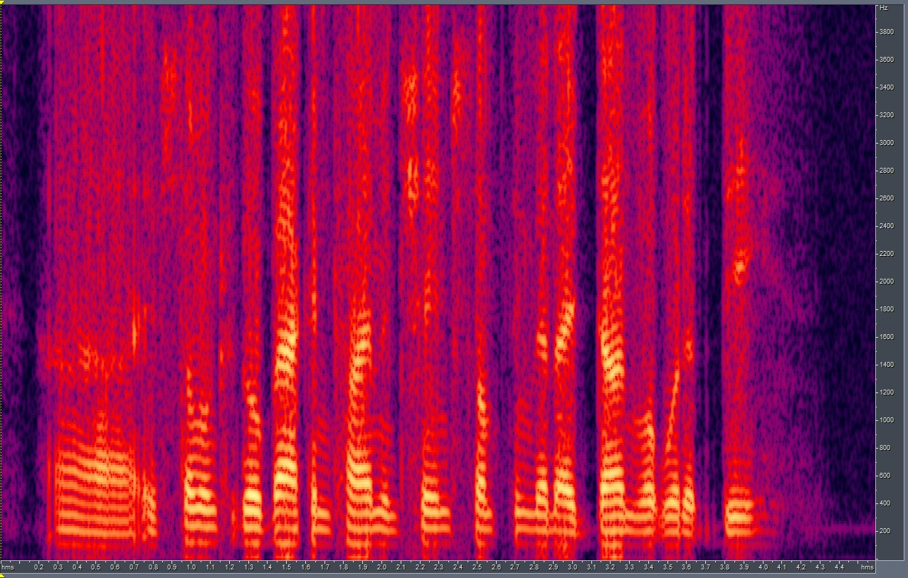
Trying to determine if CutGAN learns Codec specification:
Trained CutGAN with clean spectrograms as domain A + codec applied spectrograms as domain B.
The results were somewhat poor, with the LSD score of 8.26; still better than what SinGAN achieved when learning codec specification.
CUT output
GT

Slide 6
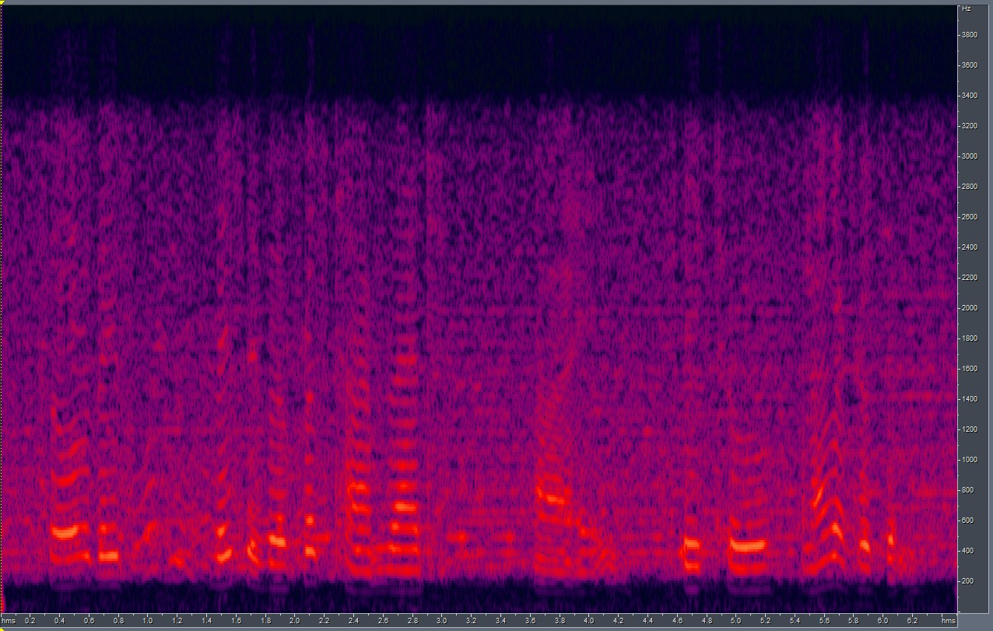

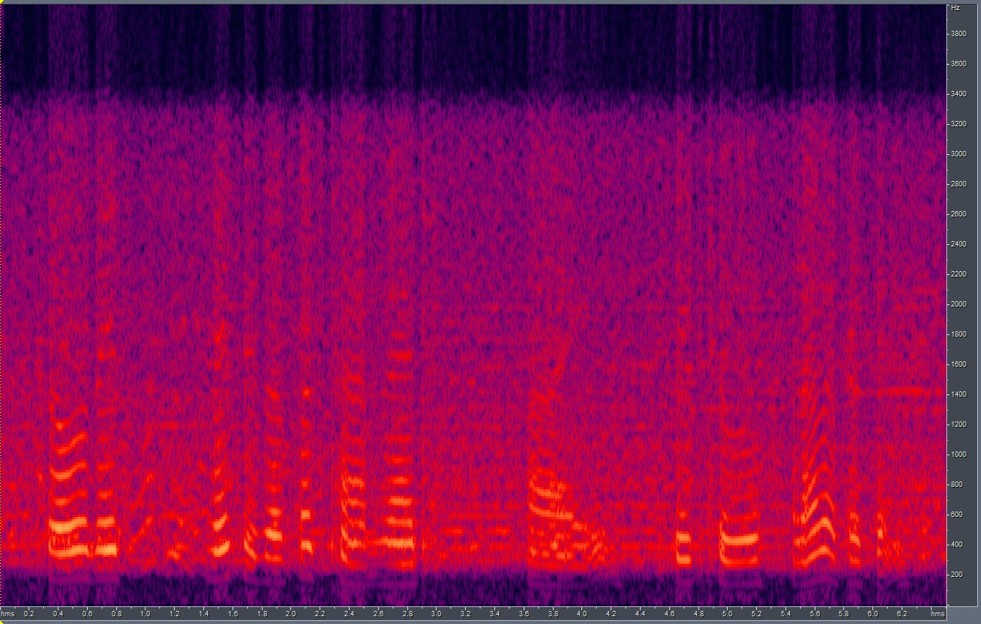
Raising spectrograms by a power before training:
Before feeding the spectrograms to CutGAN for training, we raise them by a power (here, by 2)
The results surprisingly improved:
LSD w normal-trained output: 6.14
LSD w specPower = 2: 5.31
CUT o/p when specPower = 2
GT
CUT o/p when specPower = 1 (default)

Slide 7
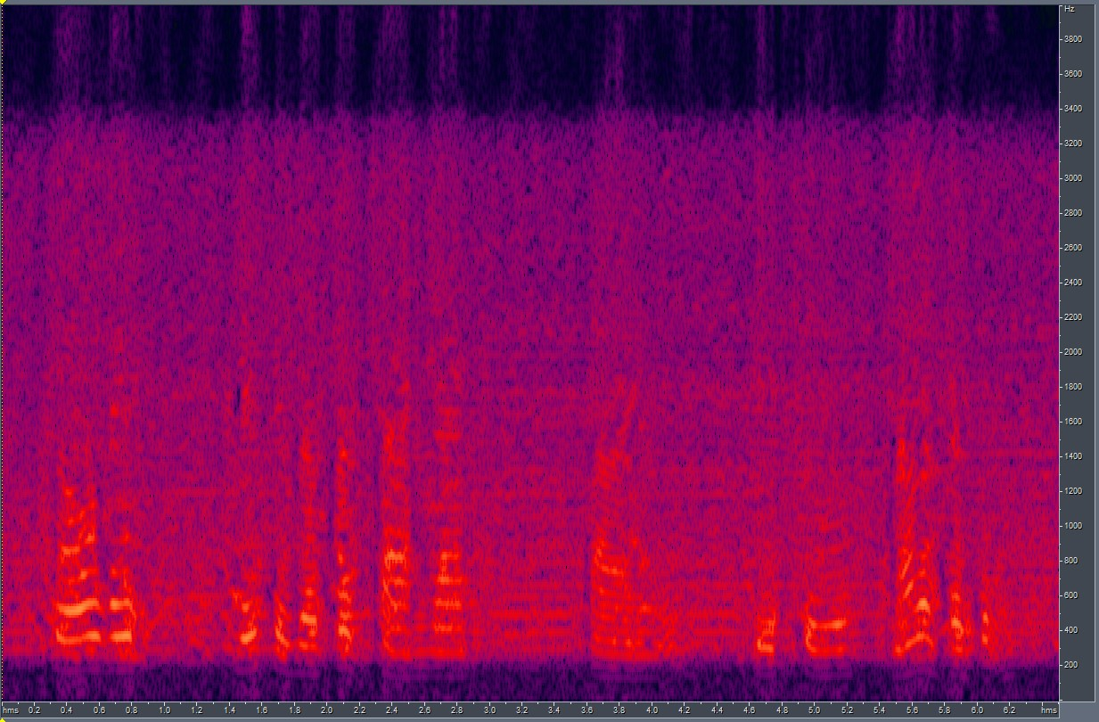
Using SinGAN + CutGAN:
Here, we train a SinGAN model on a RATS noisy sample. Then use the trained model to generate domain A audio files for CutGAN; CUT would train on SinGAN-passed Audio (domain A) → RATS noisy samples (domain B).
LSD did not vary by that much:
LSD when passed via SinGAN: 6.35
LSD w/o SinGAN: 6.82
Output
GT
w/o singan

Slide 8
End.

